Slide 1
The Two-Pointer Technique
Two Positions, One Overall Strategy

Slide 2
Introducing the Two-Pointer Technique
  Two-point is an optimised technique for algorithm design
    Attempts to improve efficiency by avoiding redundant calculations
    Creates a “clever” algorithm that tries to find short-cuts
  Example: Identifying the most frequent element
    Counts the length of “runs” of data, instead of counting the number of appearances of each element

Slide 3
Characteristics of Two-Pointer Solutions
  Unlike exhaustive search (e.g. brute force), two-pointer approaches avoid repeated work
  General concept: Two pointers strategically move through the data
  Different variants exist to solve different types of problem
    Closing window: pointers move towards each other
    Sliding window: pointers move in sync across data
    Read/write: pointers have different roles and move at different rates

Slide 4
Let’s Start With a Sample Problem
  Sample problem:
    Given a sorted array, find two values that add up (sum) to a specific target
  Example:
    [1, 3, 4, 6, 8], target = 10
    Expected pair: 4 + 6
  Brute force idea:
  Try every possible pair
    For each element in data:
      Calculate result of it plus each element after it
      1+3, 1+4, 1+6, 1+8
      3+4, 3+6, 3+8
      …
  Uses nested loops
    Checks n * n pairs at worst*
    O(n²)
Expensive
Notes:
*Remember, this is calculated using big O rules:
(n-1) + (n-2) + … + 1 + 0 = n(n-1)/2
n(n-1) = n² + n
(n² + n)/2 -> eliminate constants (per big O rules – constant increase is a fixed change; as n changes that constant cost is not noticeable in performance) -> n² + n
n² + n -> eliminate lower order terms (per big O rules – linear increase is not enough to really change the classification of the algorithm, as n changes, the linear increase is not felt nearly as much as the quadratic) -> n²

Slide 5
Identify the Repetition
  We’re not comparing the same pairs each time
    This is because the inner loop starts AFTER our current value
  Repetition: We use the values on the right many times
    8 is added to every value in the array
  Is there a way to eliminate a value early?
    If the data is unpredictable, no
    If the data is sorted, yes!

Slide 6
The Benefit of Sorted Data
  Sorted data guarantees the data is ascending
    Data trends up as you move to the right in the dataset
    [1, 3, 4, 6, 8], 1 <= 3 <= 4 <= 6 <= 8
  This predictability provides a pattern we can follow
    Move to right-> increase/stay the same
    Move to left -> decrease/stay the same
Note: This also applies for descending sorts, with data trending down moving to the right

Slide 7
The “Closing Window” Pattern:
Pointers Moving Towards Each Other
LEFT
RIGHT
1
3
4
6
↓
8
0
1
2
3
4
left = 0
Start at the first array element.
right = nums.length - 1
Start at the last array element.
At each step: Inspect the two values; make a decision; move one pointer inward.
  Moving left increases/stays the same
  Moving right decreases/stays the same

Slide 8
Worked Example of the
“Closing Window”
Stage 1: Total the data from the end positions
Data[left] + data[right]:
1 + 8 = 9
9 is smaller than our target, 10
We need a larger sum, so move left to the right by 1
LEFT
RIGHT
1
3
4
6
8
0
1
2
3
4
Question: Why not move the right pointer in (i.e. to the left)?
  That decreases the total even more, as our larger value will probably get smaller
Movements are dictated by the sort – we’re not guessing, we know which direction to move

Slide 9
Repeat the Process…
Keep going until we find a match for the target or the pointers meet
VALUES
COMPARISON
REQUIRED ACTION
OUTCOME
1 + 8
9 < 10
Move left →
LEFT++
Decision rule
sum < target:
Move left forward.
sum > target:
Move right backward.
sum == target:
Return the pair.
3 + 8
11 > 10
Move right ←
RIGHT--
3 + 6
9 < 10
Move left →
LEFT++
4 + 6
10 = 10
Found!
SUCCESS
Stop condition: If the pointers cross or meet (left >= right), no pair remains to check

Slide 10
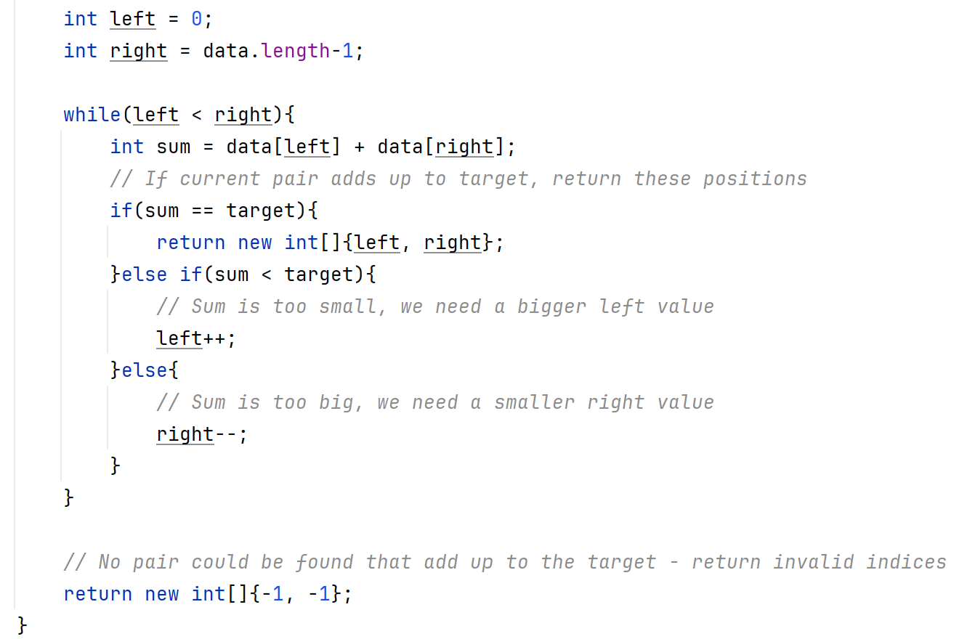
Sample Implementation
Points to Note:
Input assumption:
Data is assumed to be in sorted order
Return information:
We return positions, not actual values

Slide 11
Brute Force vs Closing Window Approach:
Complexity Comparison
  Massive difference in complexity categorisation:
    Closing window approach: linear complexity
    Brute force approach: quadratic complexity
Brute Force
Nested loops compare many pairs
For n elements, the number of pair checks grows roughly to n²
Time cost: O(n²)
Two Pointers
Left pointer only moves forward
Right pointer only moves back
Process halts when left and right meet
Time cost: O(n)
What about if sorting is needed??
Space costs: O(1) extra space needed for both, to cover pointers used
Notes:
If sorting is needed, the costs would change!
Time cost:
O(n log n) if the sort cost is O(n log n)
Time cost essentially matches the cost of the chosen sorting algorithm, as sorting is always going to be more expensive
Space cost:
If the action needs to be “pure” – i.e. have no side effects, the data must be duplicated so that the duplicate (not the original) can be sorted
Space cost for duplication: O(n)
No time cost increase as duplication time cost = O(n), which would not impact the categorisation of the original algorithm implementation

Slide 12
Problem #2: Find the Max Sum For a Contiguous Section of K Size
  Problem: Find the maximum possible sum across all possible subsections of an array with a specified size
  Examples:
    Array: [100, 100, 200, 300], section size (k) = 2
      Answer: 500 (200+300)
    Array: [1, 4, 2, 10, 25, 6, 1, 7, 18], section size (k) = 4
      Answer: 43 (2+10+25+6)
    Array: [90, 1, 45, 67, 88], section size (k) = 1
      Answer: 90 (each subarray is a single value, so this is essentially find max)

Slide 13
Brute Forcing Problem #2
Basic solution:
  Set maxSum to 0
  For each index in array up to n-k:
    Set currentSum to 0
    For each element from current index to index+k:
      Add element to currentSum
    If currentSum > maxSum:
      Set maxSum to currentSum
    Return maxSum
  Brute force idea:
  Sum up every subsection
    For each subsection of size k in data:
      Calculate sum for that subsection
      Check if it’s bigger than previous max
  Uses nested loops with different terms!
    Checks n * k sections
    O(n*k)
Implementation: b_two_pointer.utils/ArrayUtils.java
Potentially Expensive

Slide 14
Identify the Repetition
  We’re redoing a lot of the calculation!
    Array: [1, 4, 2, 10, 25, 6, 1, 7, 18], section size (k) = 4
    Add 1 + 4 + 2 + 10
    Add 4 + 2 + 10 + 25 [4 + 2 + 10 … haven’t we already done this?]
    Add 2 + 10 + 25 + 6 [2 + 10 + 25… haven’t we already done this? We’ve done 2 + 10 twice?!]
  Repetition: The subsections overlap – we reprocess each part
  What is really happening?
    One element leaves (the first one)
    One element is added (the last one)
  Is there a way to stop recalculating the overlapping parts?
    Remove the exiting element
    Add the new element

Slide 15
The “Sliding Window” Pattern:
Pointers Moving in Sync
LEFT
RIGHT
1
3
4
6
8
0
1
2
3
4
left = 0
Start at first array element (start of window).
right = left + x
Start at end of window – dependent on problem.
At each step: Calculate value within window; make a decision; move pointers to right.
  Both left and right are increased by the same amount
  Window “slides” across the array
  Some of the window is kept, avoiding recalculating/reprocessing as you go

Slide 16
Worked Example of the
“Sliding Window”
Stage 1: Calculate the sum of the first window
left = 0, right = k-1
for each index from 0 to k:
windowSum += currentValue
This gives us the window base value
LEFT
RIGHT
1
3
4
6
8
0
1
2
3
4
Question: Why is this separate from the main process?
  Value of the first window forms basis of calculation
  Remove oldest element
  Add in next element

Slide 17
Worked Example of the
“Sliding Window”
Stage 2: Slide the window to add a new element
left = 0, right = k
for each index from k to n:
windowSum -= data[k-i]
windowSum += data[i]
This gives the value of new window
LEFT
RIGHT
1
3
4
6
8
0
1
2
3
4
New window is made up of:
All elements in previous window excluding the first (i.e. remove element at left)
Element at end of this window (i.e. right)

Slide 18
Repeat the Process…
Loop all the way through the data, removing oldest element and adding a new one each time
1
3
4
6
8
Initial window: 1 + 3 + 4
Initial windowSum = 8
0
1
2
3
4
Prev
windowSum
ELIMINATED
ELEMENT
maxSum
NEW
ELEMENT
UPDATED
windowSum
right = 3 (k), left = 0 (right – k)
8
1
6
13
13
right = 4, left = 1 (right – k)
13
3
8
18
18

Slide 19
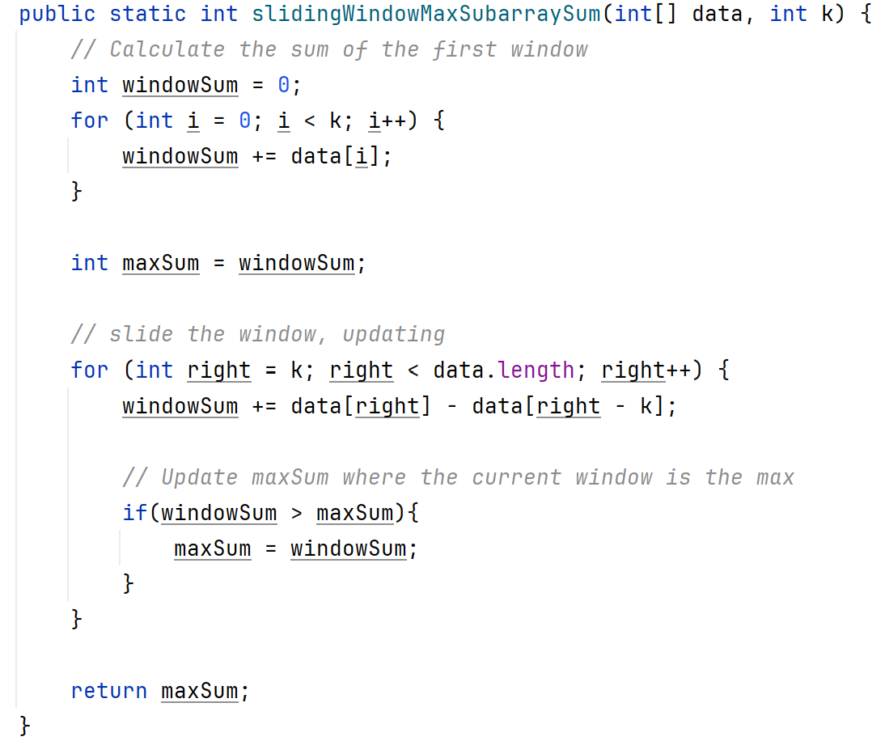
Sample Implementation
Points to Note:
Validation requirement:
Confirm the array contains sufficient elements for at least ONE subarray
Return information:
We return the total, not the values producing it (or their positions)
Implementation: b_two_pointer.utils/ArrayUtils.java

Slide 20
Brute Force vs Sliding Window Approach:
Complexity Comparison
  Massive difference in complexity categorisation:
    Sliding window approach: Linear complexity
    Brute force approach: Pseudolinear (up to quadratic!) complexity
Brute Force
Nested loops calculate sum of many overlapping subarrays of size k
Pseudolinear if the k constant is low
Quadratic if k approaches n!
Time cost: O(n*k)
Two Pointers
Left and right pointers move forward
by 1 on each iteration
Max number of steps taken: n
Time cost: O(n)
Space costs: O(1) extra space needed for both, to cover pointers used and calculation variables

Slide 21
Problem #3 Deduplicating Data In-Place
  Problem:
    Given an array of sorted data, remove all duplicate elements in-place
  Example:
    [1, 1, 1, 2, 2, 2, 3, 3, 4, 5]
  Expected result:
    [1, 2, 3, 4, 5, 0, 0, 0, 0, 0]
  Brute force idea:
  Shift data back after each run ends
    While still within data:
      If current element is different to next element:
        Shift everything back by one
        Reduce how much data is left to process
      Otherwise move forward by one
    Wipe “ghost” data from end of array
  Uses nested loops
    Iterates through all data
    Where duplicate is found, remaining data is copied backwards, even other duplicate data
    O(n²)
Notes:
Note: arraycopy() is a more efficient way to copy chunks of data than manual copying, but it still performs an O(n) loop through the data. It’s more efficient because the underlying code is done in C++, a lower-level action that can carry out block copies. Despite this, it is still considered O(n) due to the n iteration.

Slide 22
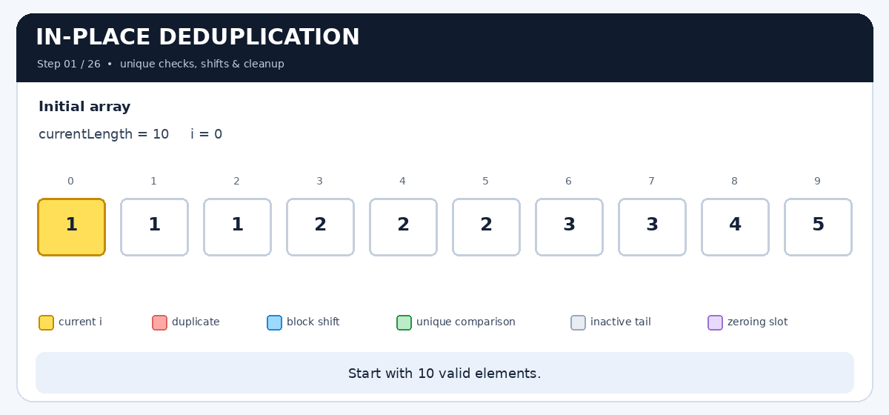
Identify the Repetition
  We’re moving a lot of data multiple times!

Slide 23
SOLVE the Repetition
  Repetition: We move the data later in the array many times over, even though we don’t know we need it
    It might be a unique value
    It might be a duplicate
  How do we stop moving the same values over and over?
    Stop moving values we don’t know we need
    Just copy the unique value

Slide 24
The Benefit of Sorted Data
  Sorted data guarantees the data is ascending
  This guarantees duplicates are grouped
    Matching elements are always beside each other
    If something doesn’t match the one before it, we should keep it -> it is the start of the next run

Slide 25
The “Read/Write” Pattern:
Pointers With Different Roles and Speeds
WRITE
READ
1
1
1
2
2
0
1
2
3
4
write = 1
Start at SECOND array element
read = write
Start at same index as write
Read pointer: “What is the next value?”
Write pointer: “Where should the next new (unique) value go?”
  write-1: Last unique value we encountered
At each step: Check if data[read] != data[write-1].
  If they are not equal: copy data[read] into data[write] and move write pointer to next slot

Slide 26
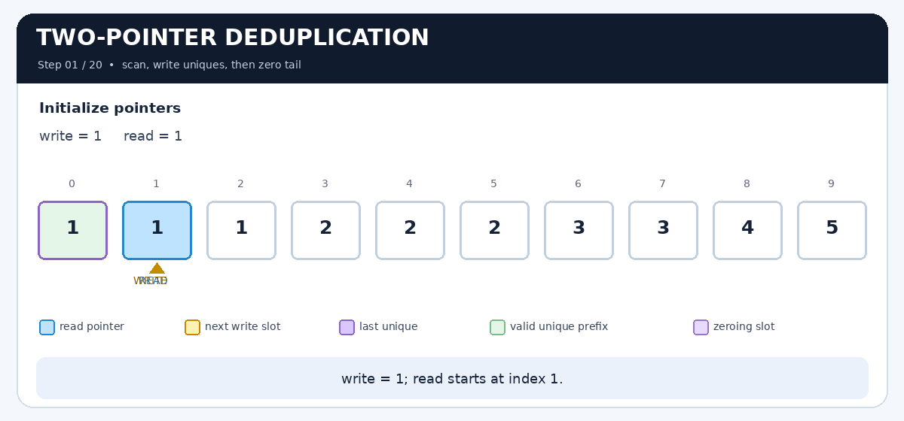
Read/Write Pointers in Action
  Read finds new values
  write tracks where to save them

Slide 27
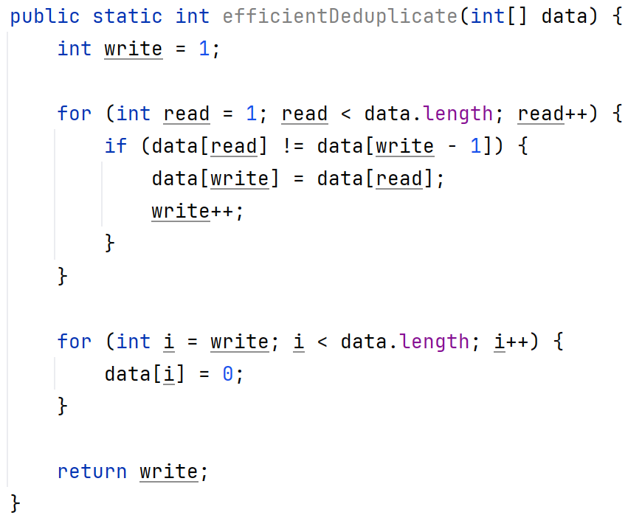
Sample Implementation
Points to Note:
Input assumption:
Data is assumed to be in sorted order
Return information:
We return a count of real data, not the array itself
Implementation: b_two_pointer.utils/ArrayUtils.java

Slide 28
Brute Force vs Read-Write Approach:
Complexity Comparison
  Massive difference in complexity categorisation:
    Read-write approach: Linear complexity
    Brute force approach: Quadratic complexity
Brute Force
Nested loops shift overlapping subsections down in array
Time cost: O(n²)
Two Pointers
Write pointer moves forward when a new value is saved
Read pointer moves forward on every iteration
Max number of steps taken: n
Time cost: O(n)
Space costs: O(1) extra space needed for both, to cover pointers used
Notes:
Both versions have an O(n) operations to replace all “ghost” data, but it never overpowers (and therefore increases) the cost of the deduplication itself

Slide 29
How to Recognise a Two-Pointer Problem
  Two pointer problems use safe pointer movement to eliminate possibilities
    Safe movement is key – we need to know we won’t miss anything when ruling out data
  Common situations:
Closing Window
Data is sorted/sortable
Task is to identify pairs/triplets
Task is symmetrical, e.g. identify palindrome
Sliding Window
Working with continuous sections
Examining for a specific property (sum, average, unique count etc)
Find max, min, longest
Read-Write
Usually for in-place work
Useful for filtering data, e.g. removing duplicates or a specific value

Slide 30
Decision Flow Chart:
Which (If Any) Two-Pointer Should I Use?
Is the data sorted and looking for a pair/symmetry?
Yes
No
Closing window
Are you analysing a continuous section?
Yes
No
Sliding window
Is it an in-place modification/filtering?
Yes
No
Read-write
Try
something else!

Slide 31
Practice Problem #1:
Palindrome Detector
  Palindrome: A word that reads the same left to right as it does right to left
    E.g. R-A-C-E-C-A-R
  What approach would you use to solve this?

Slide 32
Practice Problem #1:
Palindrome Detector
  Palindrome: A word that reads the same left to right as it does right to left
    E.g. R-A-C-E-C-A-R
  Suggested solution: Closing window
    Compare left and right:
      If they differ, return false
      If not, move left and right inwards
    If left and right pointers meet or cross, return true
LEFT
RIGHT
L
E
V
E
↓
L
0
1
2
3
4
Challenge: Implement this from the provided partial pseudocode!

Slide 33
Practice Problem #2:
Reverse an Array In-Place
  Given an array, reverse its contents
  Requirements:
    You must use two pointers for your solution
    You may not use a second array
    You must identify the time and space complexity
Remember
Pick pointers to match the structure of the problem.
Every move needs a reason.
The goal isn’t code memorisation, it’s understanding how we can use the steps to eliminate possibilities

Slide 34
Advantages & Disadvantages
  Advantages of a two-pointer approach:
    Efficient! Often reduces brute force O(n²) costs to O(n)
    Conservative! Almost all two-pointer solutions are done in-place, with O(1) auxillery memory costs
    Lowers overhead on hardware – sequential access of data avoids jumping around memory
  Disadvantages:
    High dependence on pre-sorted data
    Narrow applicability – works excellently on specific subset of problems
      Requires contiguity (unbroken sequences) or predictable changes
    Error-prone – even the best developers fall prey to off-by-one errors and infinite loops when pointers aren’t updated correctly in all cases

Slide 35
Comparing Two-Pointer to Brute Force
Comparison | Two-Pointer | Brute Force
Time complexity | O(n) – Linear cost, highly efficient | O(n²) – Quadratic cost, slow for large datasets
Space complexity | O(1) – Constant, usually in-place | Often O(n) – Requires extra arrays or hash maps
Implementation | Tricky to get right, prone to off-by-one errors | Straightforward, relies on simple nested loops
Data Constraints | Frequently needs sorted data (or positive data) | Can usually deal with unsorted/any data

